Slide 1
Opening an Italian restaurant in the city of Montreal Prepared by Youssef Charradi April 30, 2021
Project - The battle of Neighborhoods

Slide 2
Introduction
Montreal (Canada) is one of the biggest cities around the world that attracts millions of immigrants and tourists every year.
It has a multinational cultural heritage that makes its cultural landscape particularly vibrant, and this is clearly reflected through the richness and diversity of the restauration scene.
In addition to that, Montreal has the highest restaurants per capita in north America after NewYork, which makes the Restauration industry highly competitive sector especially for the well established cultures like the Italian culture. So opening an Italian restaurant business is not a simple task.

Slide 3
Problem
In order to open a restaurant to serve Italian pizzas, choosing the right location in Montreal is crucial for the success of the business. It is important to locate the best available spots around the city.
The city is renewed for the remarquable number of potential locations that exists: Beautiful neighborhoods, walkable areas, easy access by public transport means and bikes, closeness to museums and parks...
In this study, we will work on identifying the list of addresses for best possible locations to open an Italian Pizza restaurant.

Slide 4
Data
The website "wikipedia" offers an overview of the boroughs in Montreal, with the size of the area and the density of the population. This can be used to draw a map of the possible spots, We will use BeautifulSoup library to extract and parse data from Wikipidea page.
We will use Google Geocode API to identify the Borough centers. Then we will create list of potential locations and their geographic coordinates.
We will use Foursquare API in order to get information about the nearby venues to the generated locations
We will use Google Geocode API to reverse the information and get the list of adresses

Slide 5
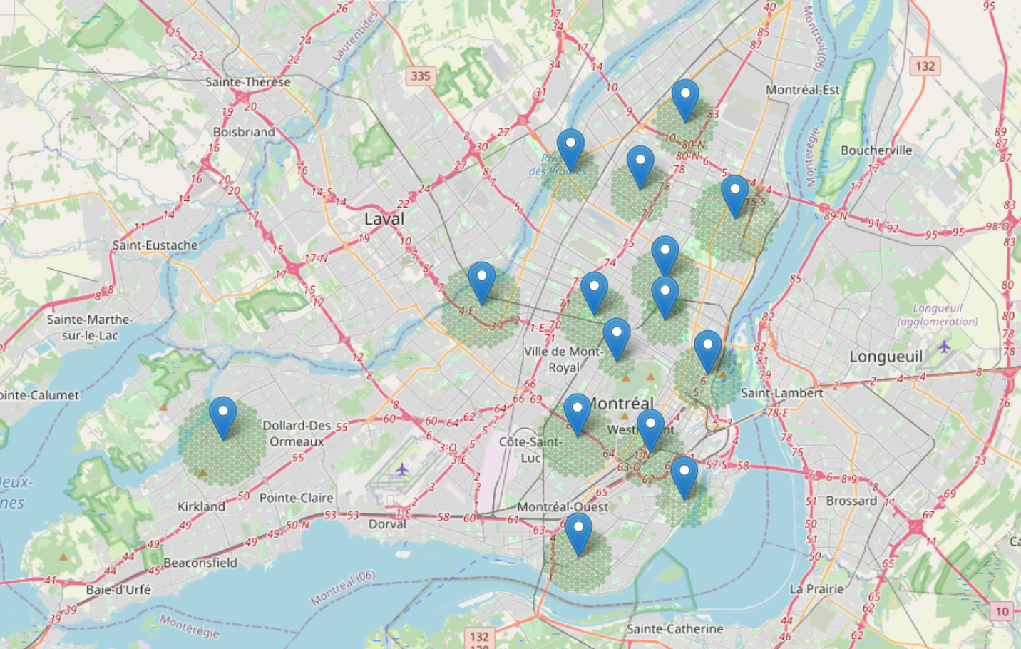
Creation of the Potential locations
Folium map of Montreal that contains:
15 Boroughs
1725 generated locations, with a distance of 400 meters form each others

Slide 6
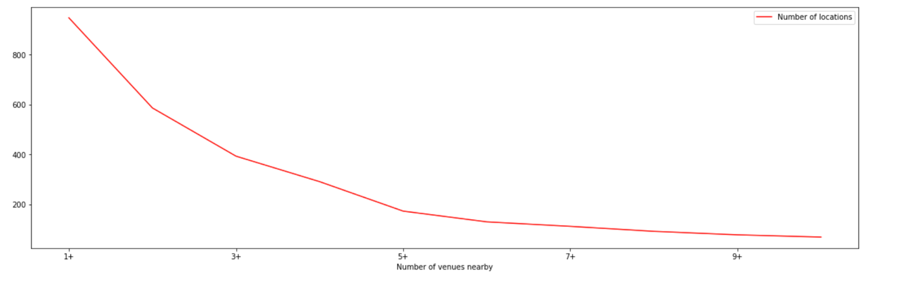
Using Foursquare information to narrow down the locations number
Filter 1: Remove locations that has an Italian restaurant in their vicinity
Result: Number of locations went from 1725 to 947
Filter 2: Remove locations that has very low number of nearby venues (3 or less)
Result: Number of locations went from 947 to 291

Slide 7
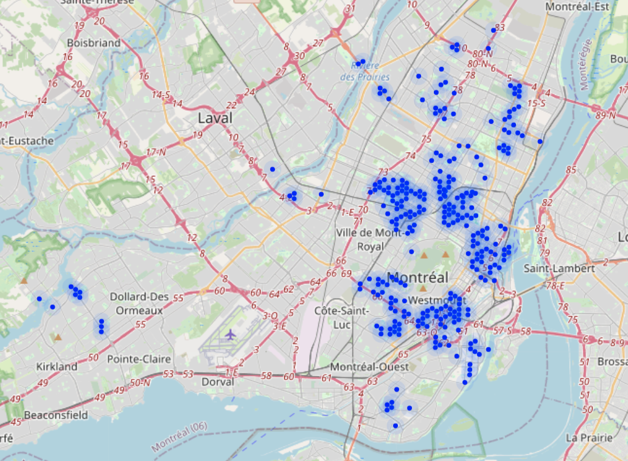
291 potential locations, but they are still scattered
We need to find another tool to compare between these locations:
1- We need to cluster the locations into groups
2-We need to identify new methods of comparaison

Slide 8
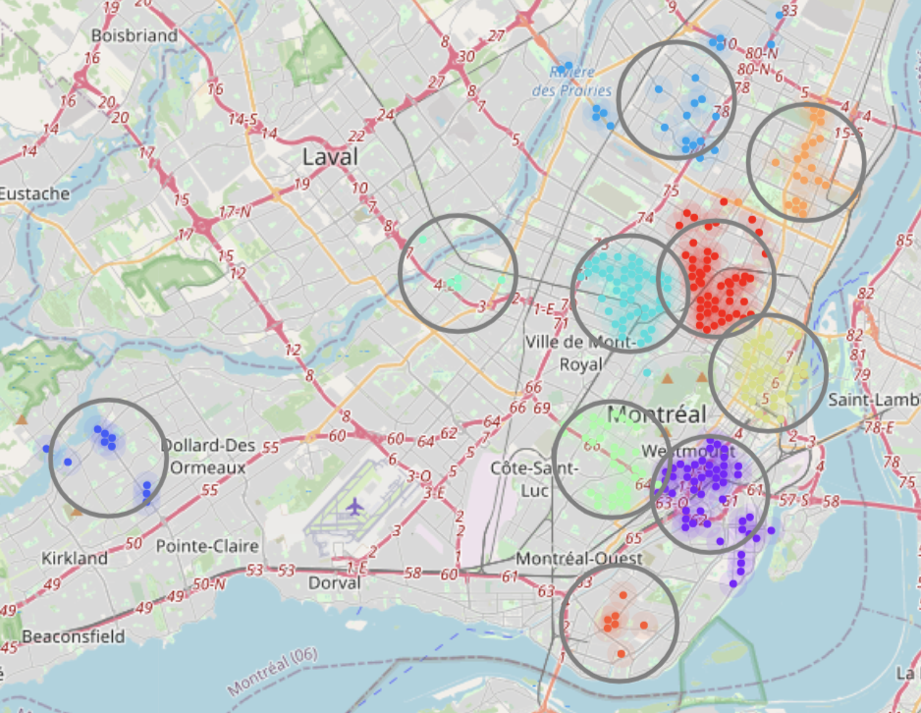
10 clusters were generated
The cluster size is between 5 and 50 locations.
Most of clusters are located in on or two Boroughs.

Slide 9
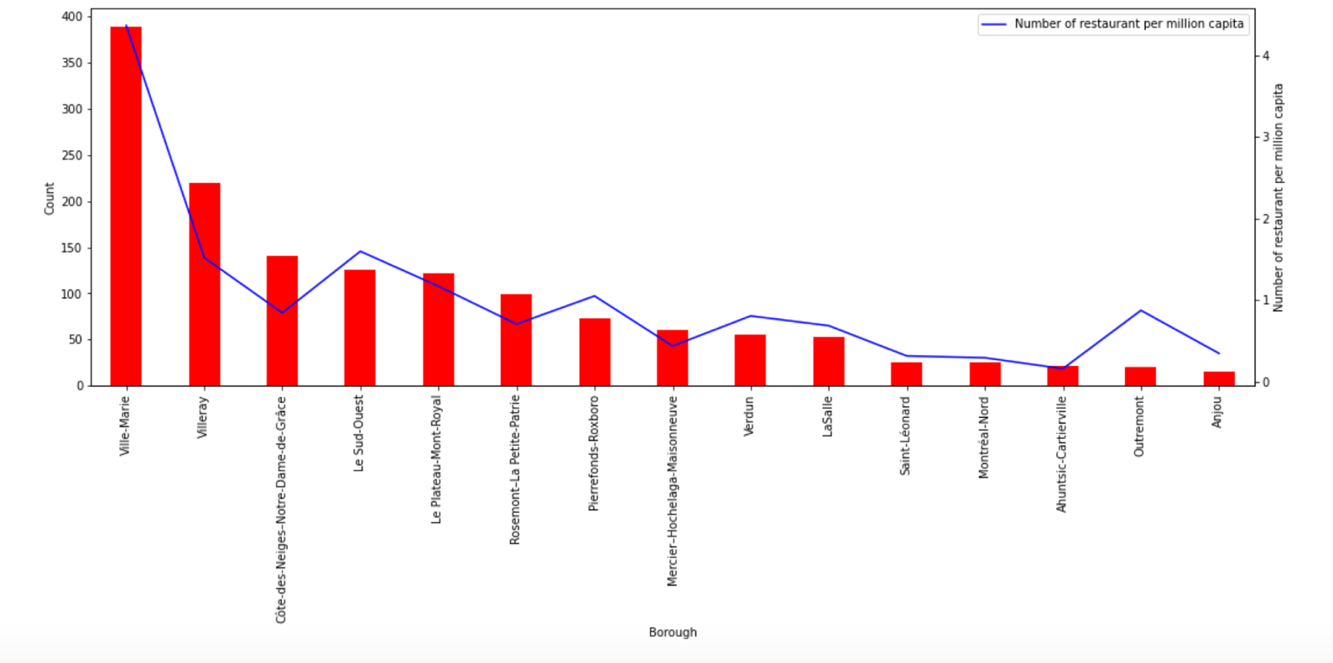
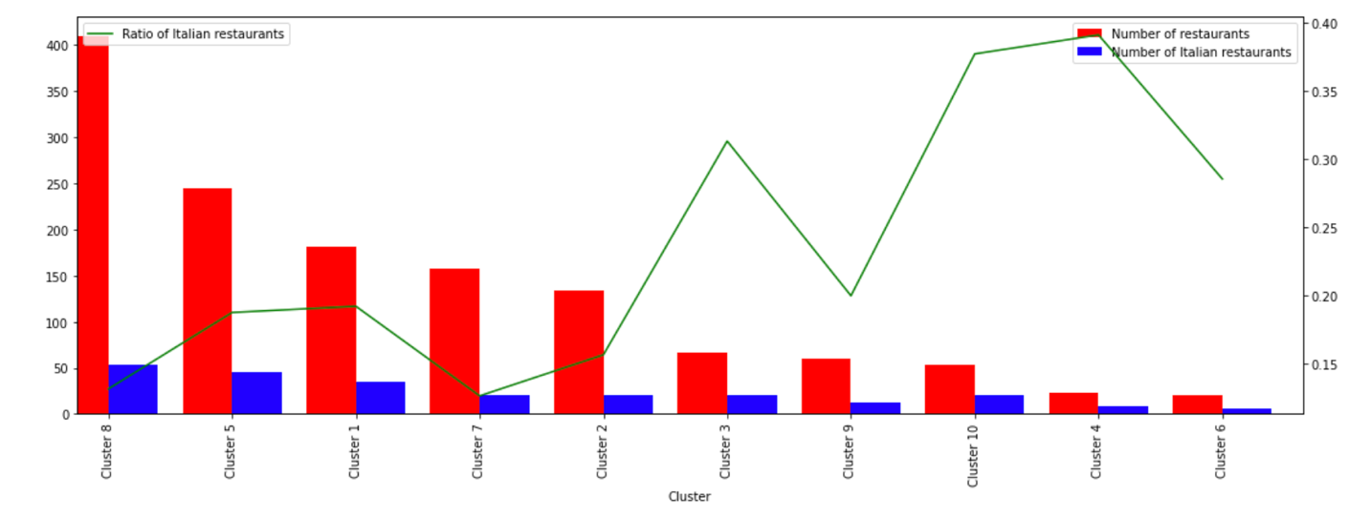
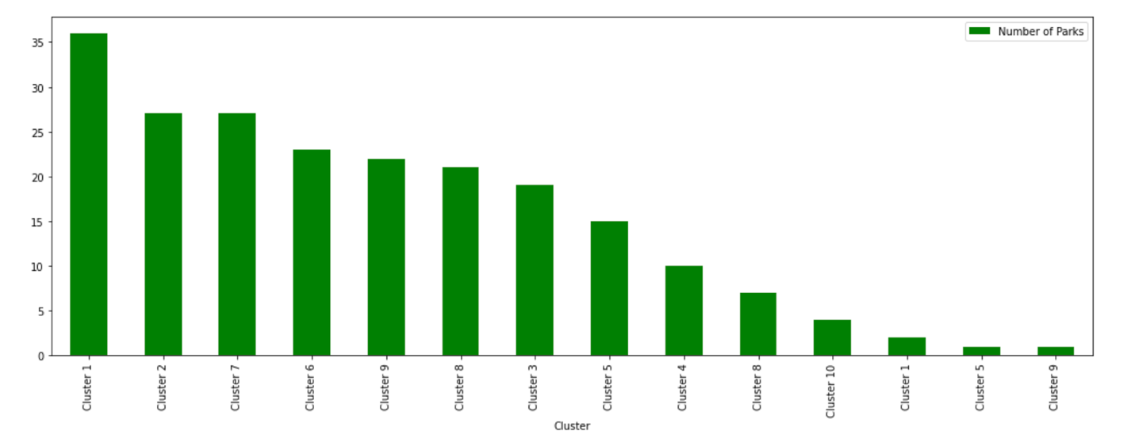
Deep analysis limit locations in clusters 1,7 and 2
Ville Marie (Cluster 8) has a very high number of restaurants per capita.
Clusters 8, 1, 5, 7 and 2 have a low Italian restaurant proportion
Cluster 1 with highest number of parks

Slide 10
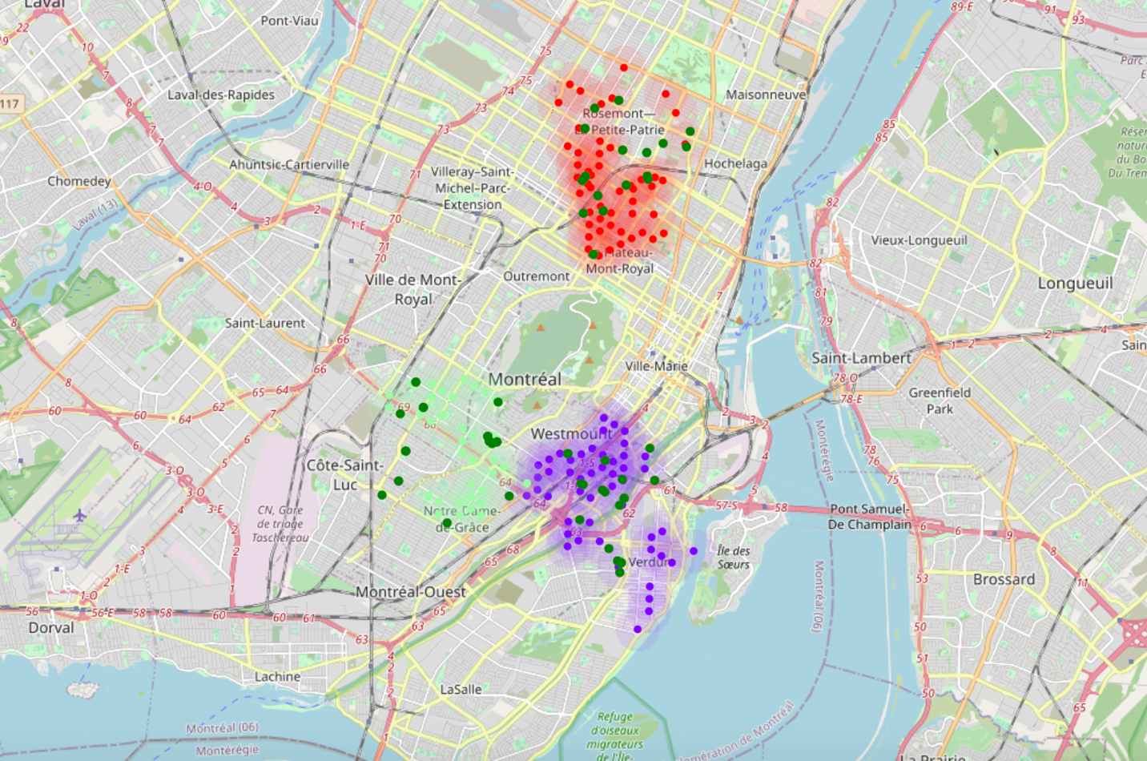
Final results: An overview of the generated locations
We started the study by creating 1725 potential candidates locations around the city most dense areas, and we ended up narrowing the data until we reached a number of 134 locations grouped into 3 clusters.

Slide 11
Conclusion
Stakeholders can rely on this study and bring an additional layer of analysis:
Use the proximity to the metro stations and the bus stops that exists in the city.
Study the distribution of the renting price of the real estate for the selected zones.
Possibility to explore Foursquare platform even deeper > Build a Machine Learning Classification Model:
Provide the list of features of a new restaurants (for example providing the list of services, prices, features …)
Evaluate how the model would predict the success of these restaurant based on the visitor rating.

